Slide 1
Web Development UE22CS242A Mini Project
Title : Bank Management System
Team members:
Vineet Goel PES1UG22CS697
Vundela Vipul kumar reddy PES1UG22CS709
Veluru SL Dheeraj Chowdary PES1UG22CS684

Slide 2
About
The Bank Management System website is a comprehensive platform designed to provide users with a seamless and secure banking experience. The home page serves as a gateway, offering an intuitive interface and easy navigation. Users can register for an account through the registration page, where they provide essential information for account creation.
Upon registration, users can log in to access their personalized dashboard, featuring the check balance and user profile pages. The check balance page allows users to monitor their account balances and transaction history in real-time, ensuring transparency and control over their finances. The user profile page enables account customization and management of personal information.
For those seeking financial assistance, the loan page offers details on available loan options, interest rates, and application procedures. The credit card page provides information on credit card offerings, benefits, and application processes.
To enhance transparency and trust, the about us page outlines the mission, values, and history of the bank, while the contact us page facilitates communication between users and customer support. The website is designed with a responsive and user-friendly interface, employing HTML for structure, CSS for styling, and JavaScript for dynamic functionalities, ensuring a seamless and secure banking experience for users.

Slide 3
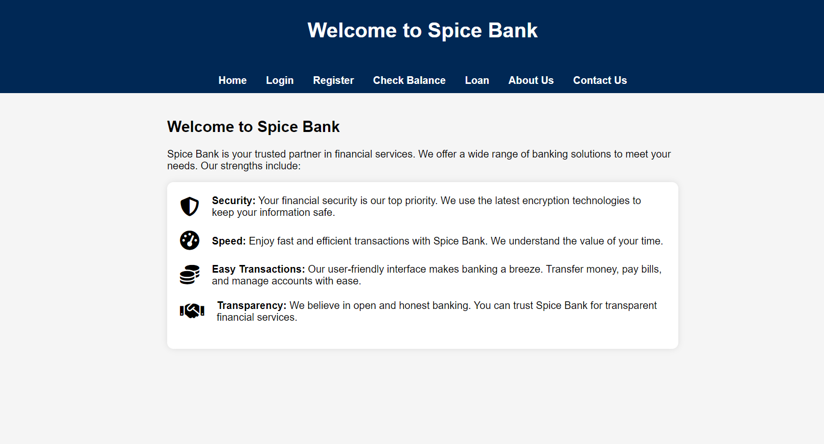
Home

Slide 4

Login Page

Slide 5
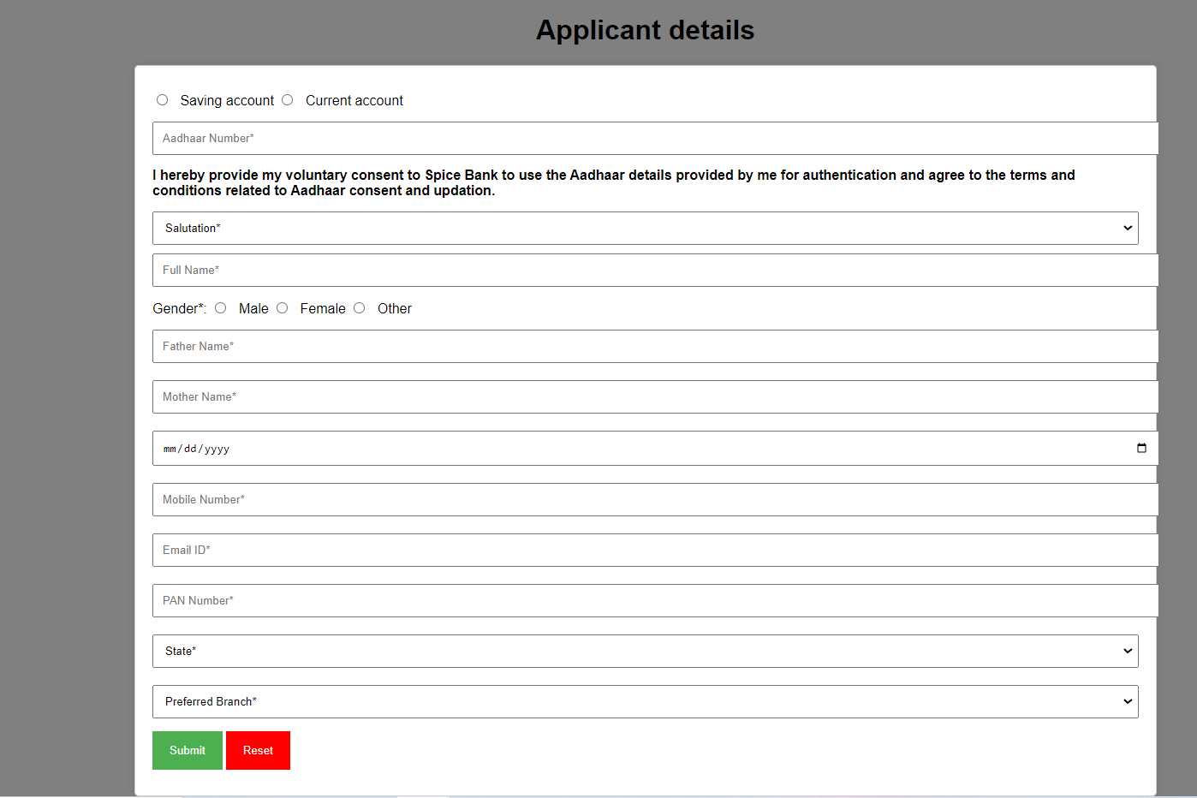
Register

Slide 6
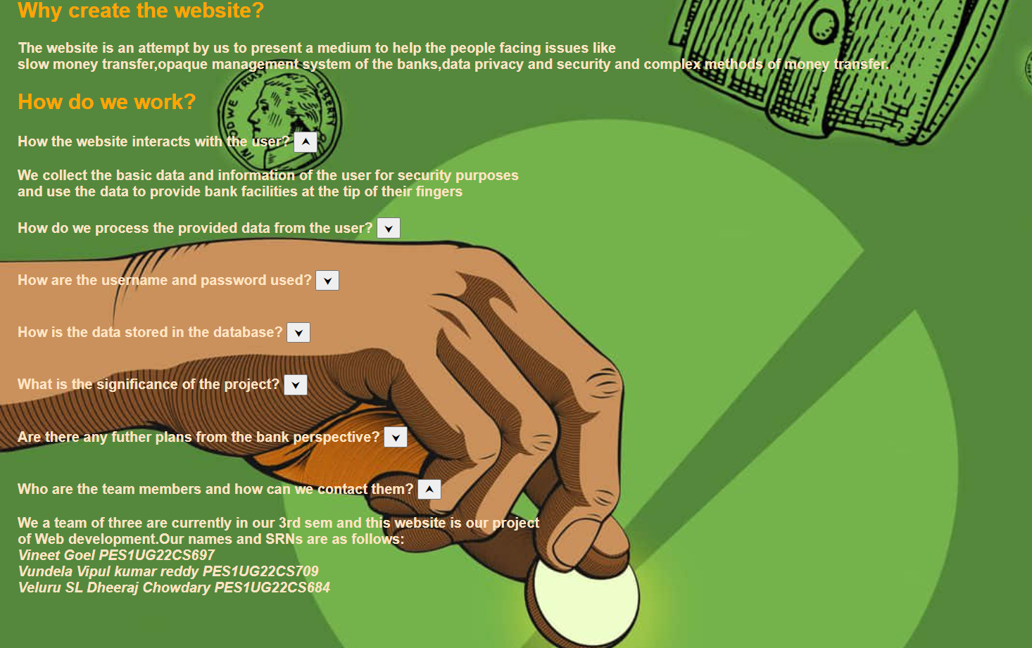
About us

Slide 7
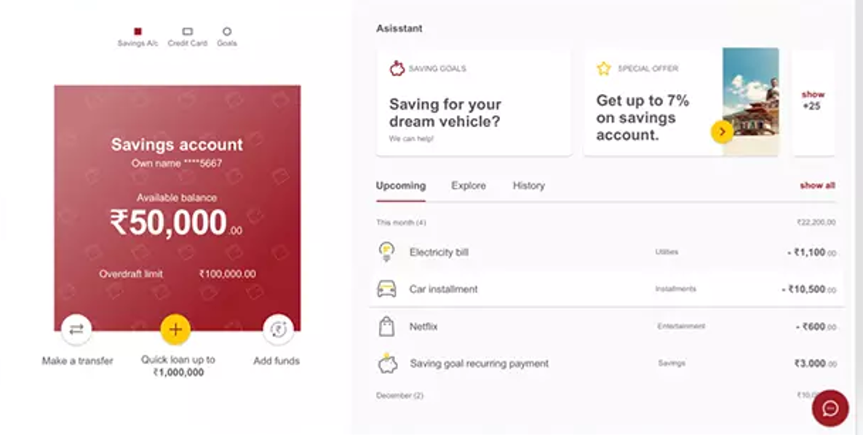
User Profile Page

Slide 8
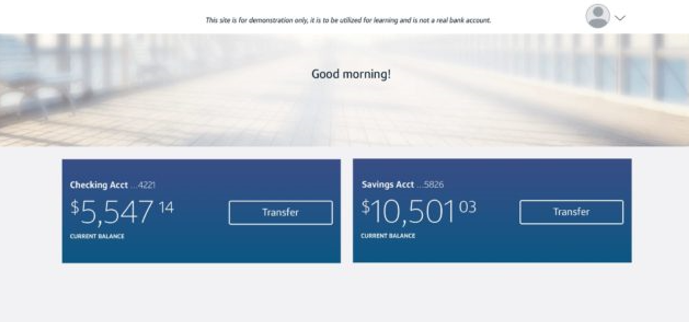
Check Balance

Slide 9
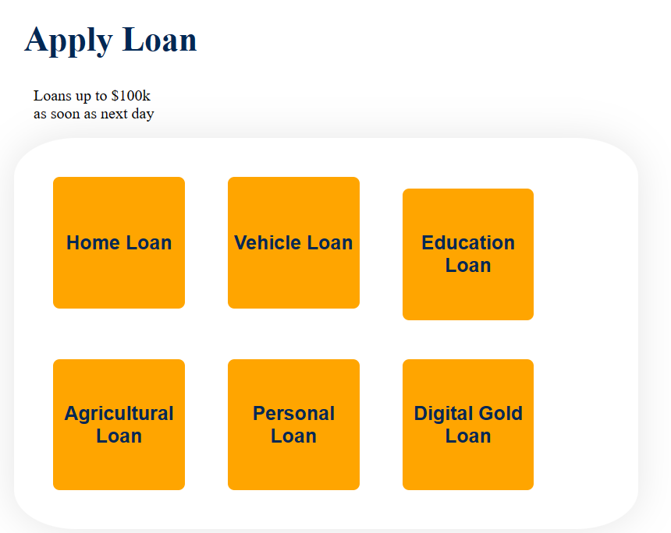
Loan

Slide 10
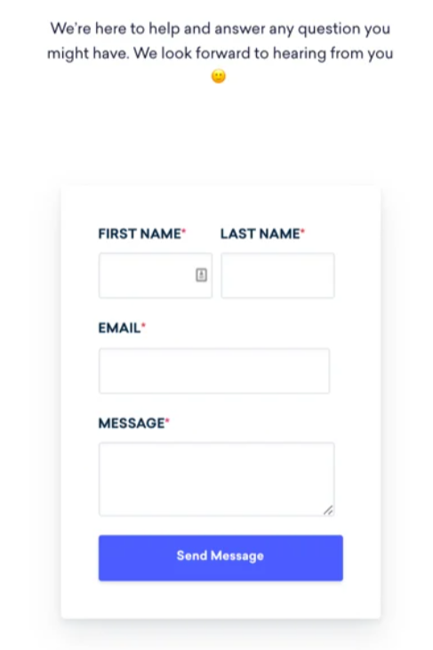
Contact us

Slide 11
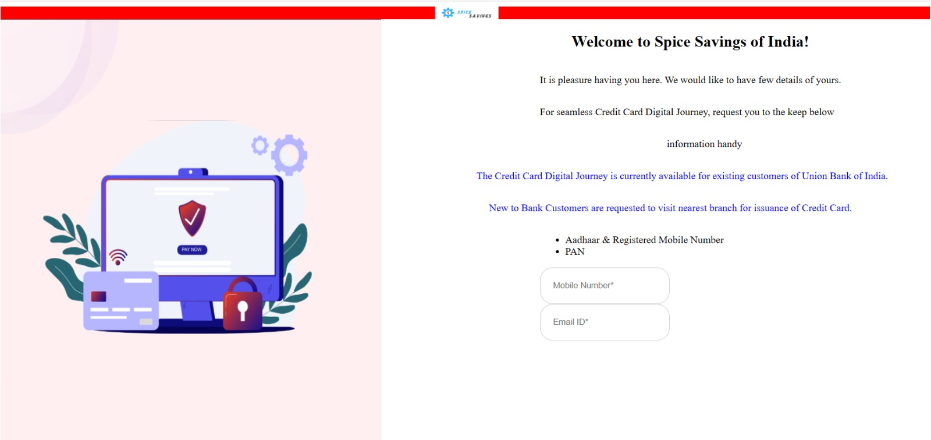
Online Credit Card

